Slide 1
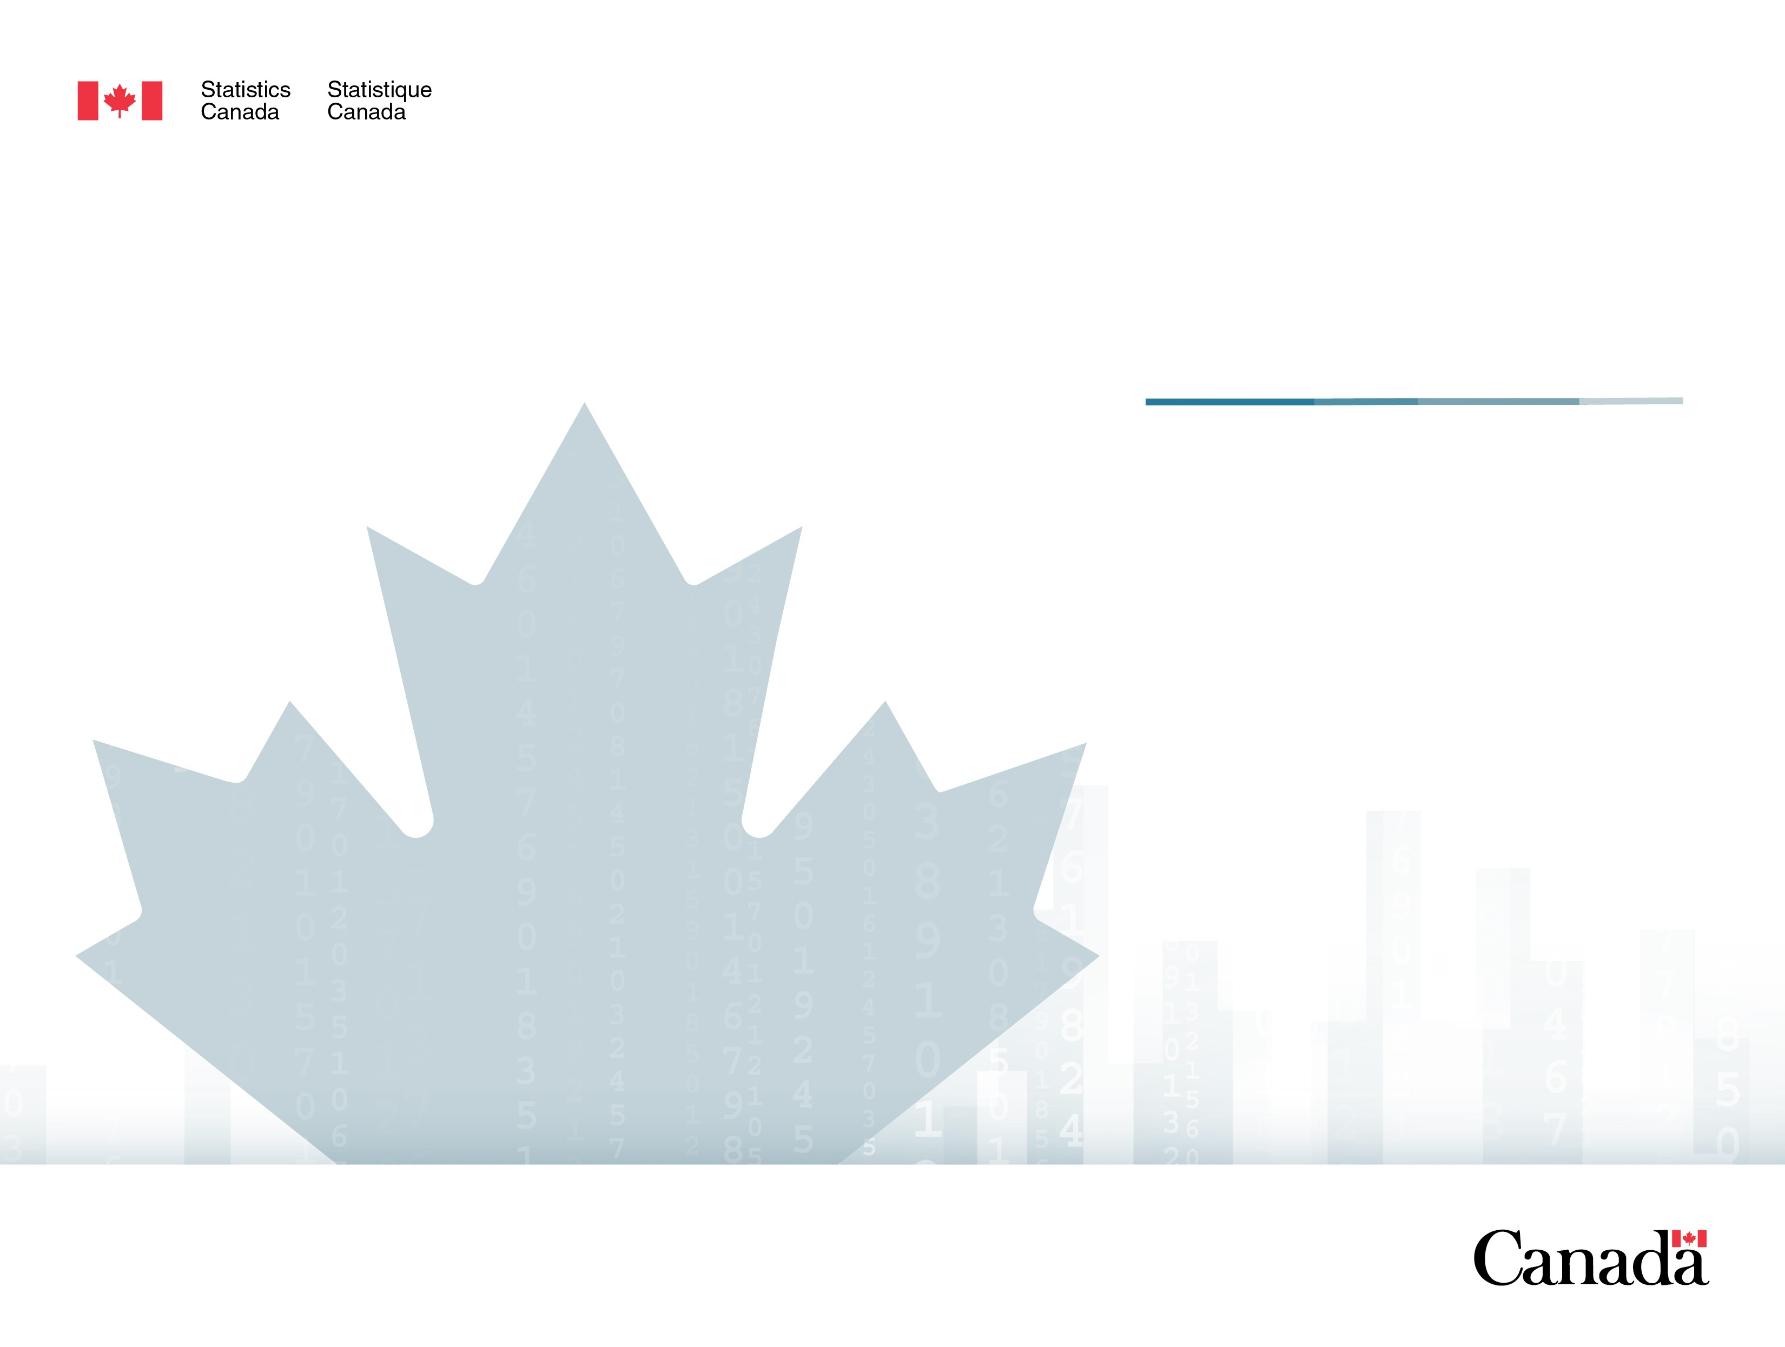
DLI Update
Fall 2018
Microdata Access Division
Statistics Canada
November 27 2018

Slide 2
Status of the DLI
EAC changes in membership
DLI community membership has increased by 2 so far this year with more inquiries
Staffing changes
Statistics Canada’s cost remains at 31%
Notes:
2 new members are: Durham, Camosun College,

Slide 3
DLI Activities
The Level of activity on the DLI listserv was over 500 posts from May 1 to Sept 1 and continues to be active this fall.
Note: 2018/19 is from April 1 to September 30, 2018

Slide 4
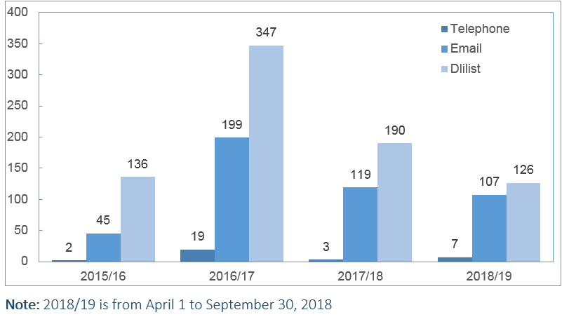
DLI Activities
The DLI team has responded to over 200 requests from the DLI listserv and the team email address this fiscal.

Slide 5
Training and Outreach
Training Sessions
  National Training Day and Boot camp: May 2,3, 2018
  Western Training: Nov 27-29, 2018
  Ontario Training: Dec 4-5, 2018
Webinars
  For new members and potential clients

Slide 6
Managing the DLI Collection
The PUMF collection in the DLI continues to grow year over year. There are another 7 PUMFS files anticipated to be released this year including the Census Long Form.
Note: 2018/19 is from April 1 to September 30, 2018
Notes:
PUMFs
General Social Survey (GSS) - Canadians at Work and Home Cycle 30 (2016)
Survey of Financial Security (SFS) 2016
Travel Survey of Residents of Canada (TSRC) 2017
Labour Force Survey (LFS) 2018 (March to August)
Canadian Income Survey (CIS) 2016
Other data products were also added including:
International Merchandise Trade Data (IMTD) 2015-2017,
Financial Information of Universities and Colleges (FIUC) 2016/2017,
CIHI Discharge Abstract Database (DAD) 2016-17
Tuition and Living Accommodation Costs (TLAC) - Standard Tables 2018-2019

Slide 7
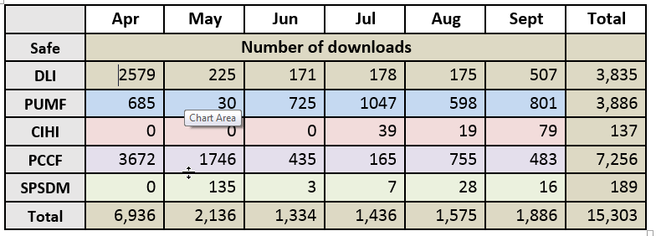
Managing the DLI Collection
DLI Contacts downloaded over 15,000 PUMF from April 1 to Sept 30,2018.
Notes:
DLI safe contains reports, aggregate data tables like Census, older (pre2013) national accounts tables.
PUMF contains only PUMFs and documentation related to them.

Slide 8
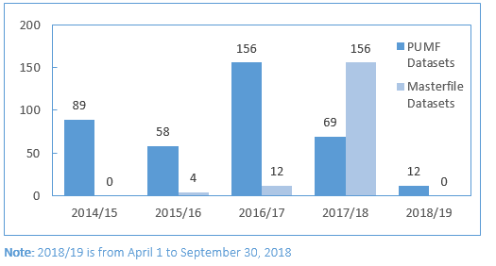
Managing the DLI Collection
The target for this fiscal year is 75 PUMFs and 75 Masterfiles published to Nesstar. We are on track to meet our goal.
Notes:
Top 5 files downloaded from StatCan Nesstar:
Census of Population 2006 Individuals File
Canadian Community Health Survey 2010 Annual Component
Canadian Community Health Survey 2012 Annual Component
Canadian Community Health Survey 2007-2008
General Social Survey 2013 Cycle 27: Social Identity

Slide 9
Managing the DLI Collection
Downloads of DLI products on secondary data distributers
  Abacus Dataverse Network – 3,800 downloads
  CHASS – no metrics for this fiscal
  ODESI – 7,800 downloads

Slide 10
DLI Infrastructure
Search platform – modifications to functionality are being implemented
DLI listserv archive
Notes:
Search - abbreviations, wildcard, highlight results, sort results function

Slide 11
Priorities for 2018/19
DLI Contact and Alternate Survey
Inventory of datasets at risk of obsolescence
PUMF Discoverability = Search Tool
  Housed in Picasso (new IMDB)
  DOIs

Slide 12
Real Time Remote Access (RTRA)
Online Application to run data analysis in a secure location
  Increasing number of surveys available
  10 Datasets added this fiscal
  Pilot of Survey of Household Spending successful and is now a permanent offering. Soon more years will be included
  Descriptive statistics available (frequency, mean, percentile, percentage distribution, proportion, ratio and share ( relationship between two continuous variables)
  Additional Statistics will be released shortly: level change, percent change, significance test
GUI interface
  Create environment to select datasets, variables, and data steps, by providing a platform that is accessible via Web Browser and write SAS code based on selections
  Should increase successful submissions
Notes:
Additional statistics:
The RTRA Program is preparing to release additional statistics, referred to as “Level 5 Statistics.” These statistics, also know has higher level statistics, calculate differences between the statistics that are available in the RTRA system. There are three different types of level 5 statistics: level change, percent change, and significance test. Level 5 statistics also come with three methods of calculation: global, base value, and sequential. These methods refer to how the values in the table cells are compared to one another.

