Slide 1
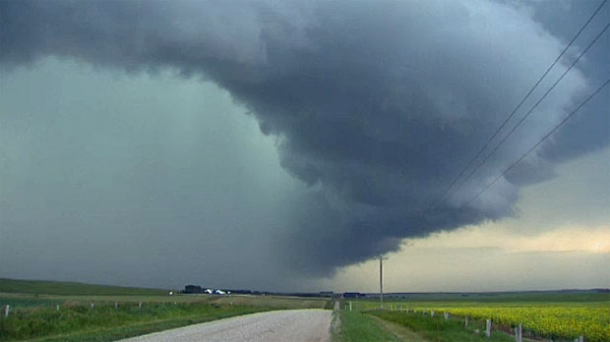
HAIL DATA!
A Data Preservation Saga
Sandra Schwab
Larry Laliberte
Anna Bombak
University of Alberta Libraries
Digital Initiatives

Slide 2
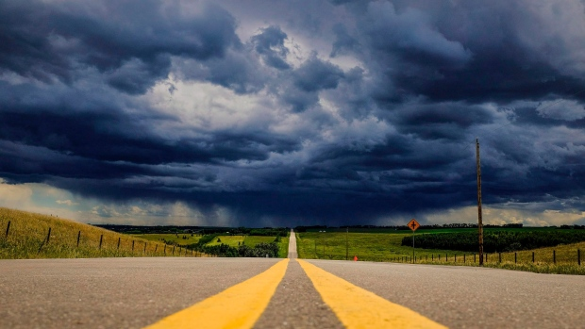
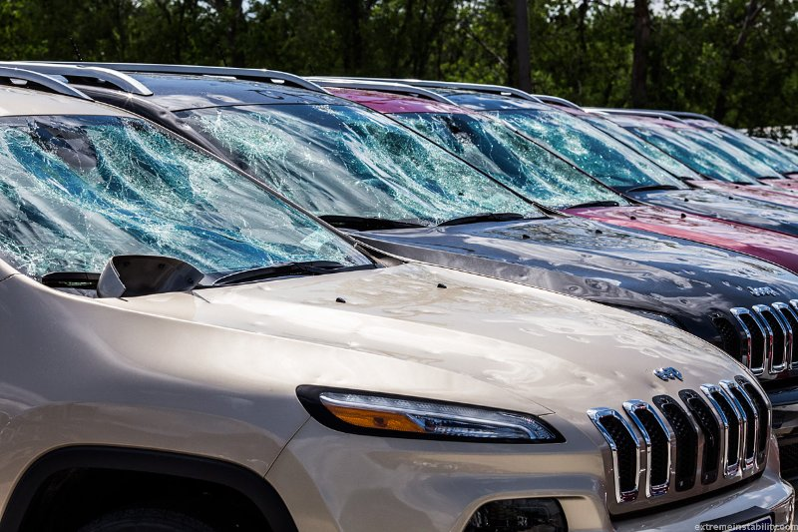
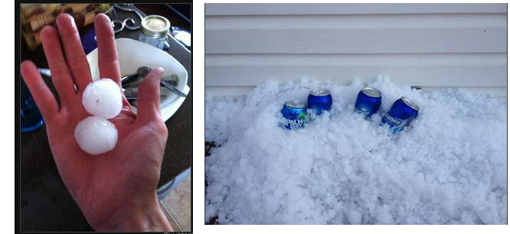
Alberta’s “Hailstorm Alley”

Slide 3
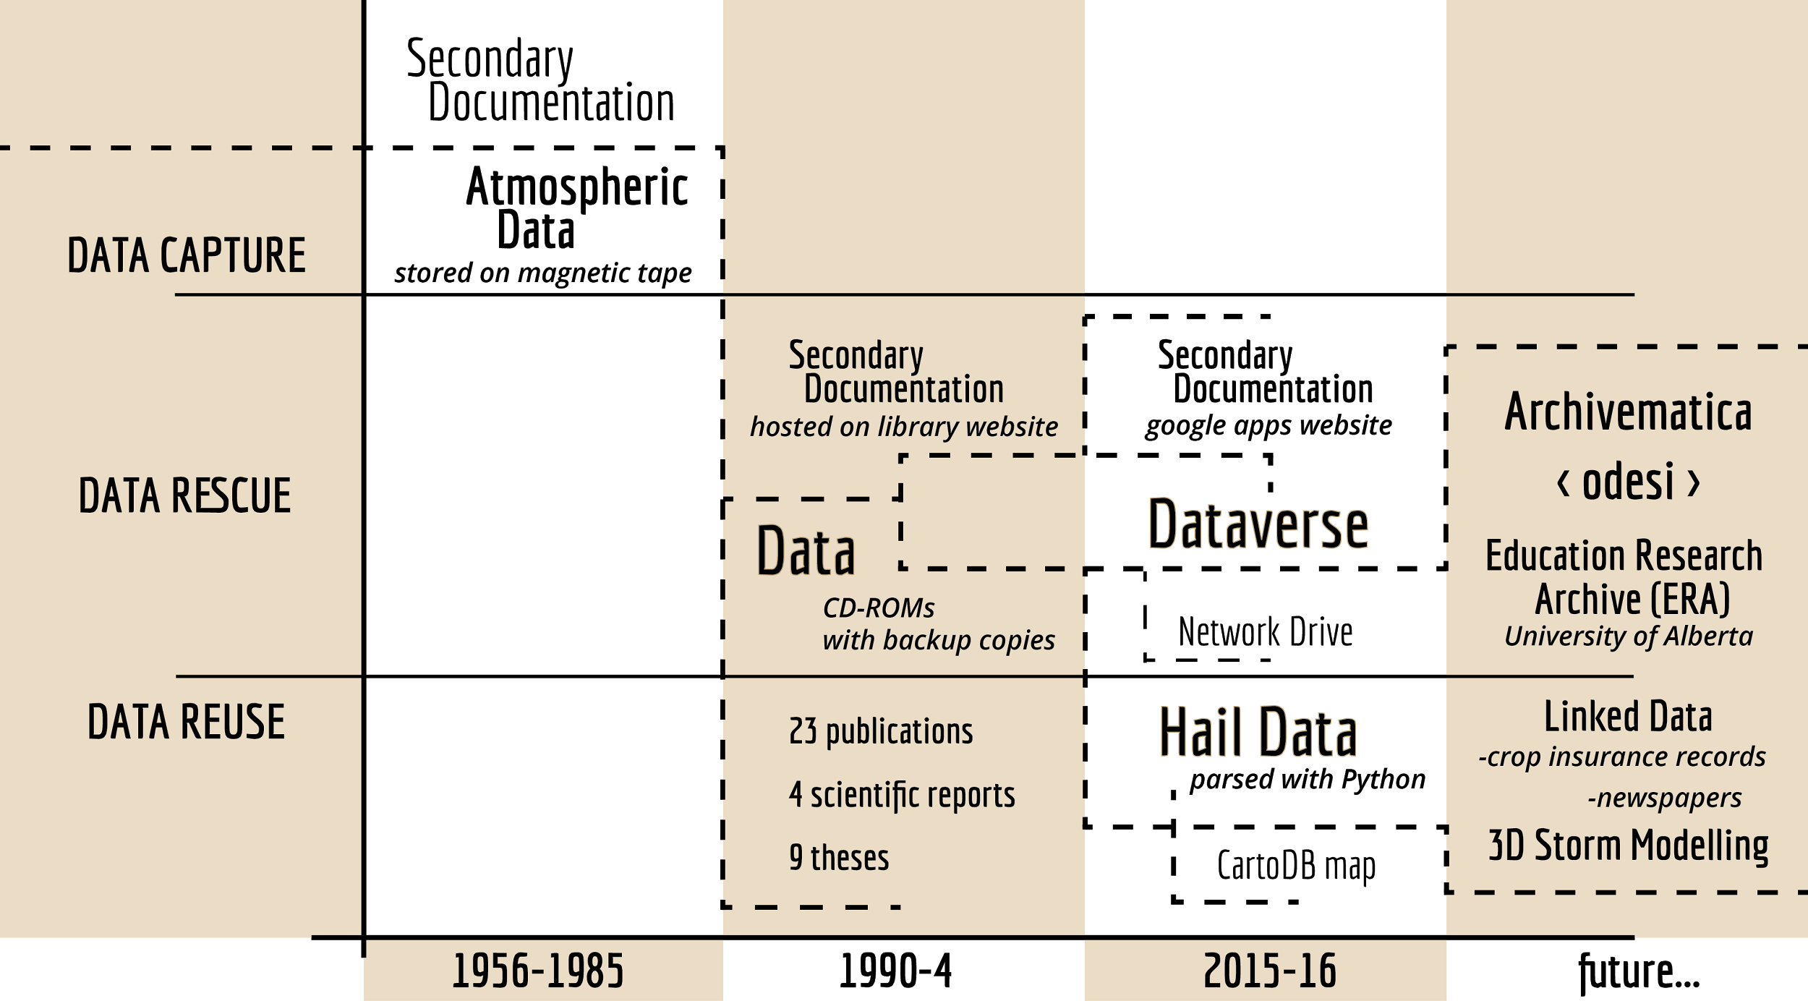
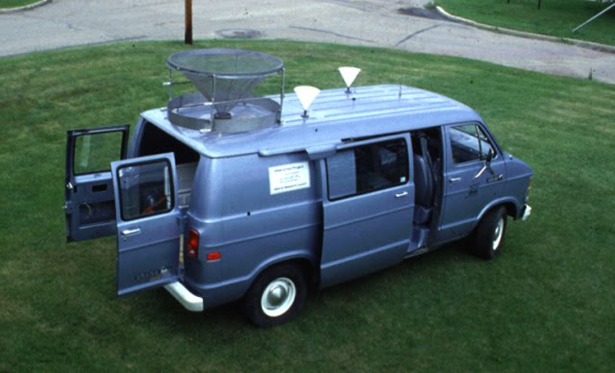


Slide 4
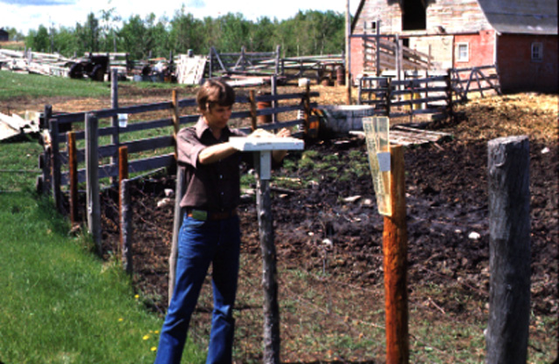

Slide 5
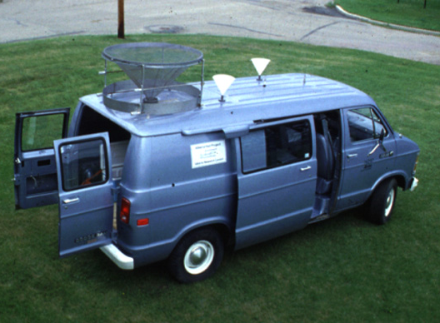
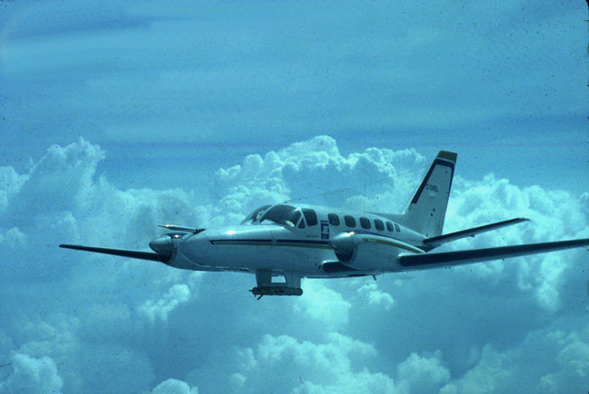
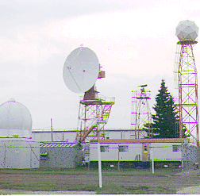
Notes:
ANNA: original data collection by ARC

Slide 6
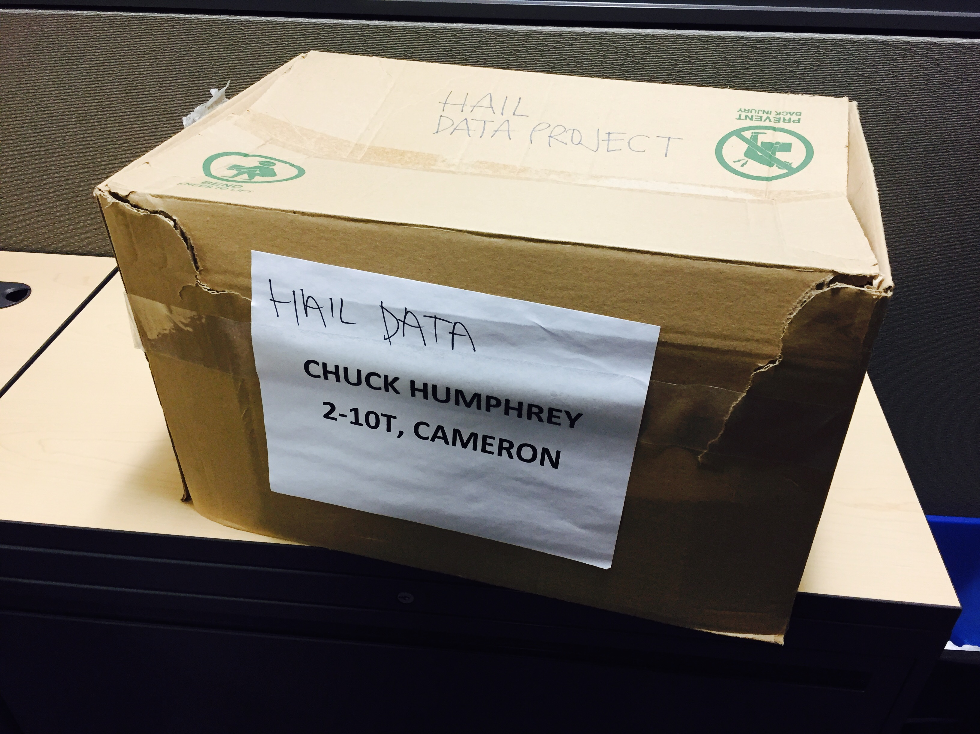

Picture of the box of cds

Slide 7
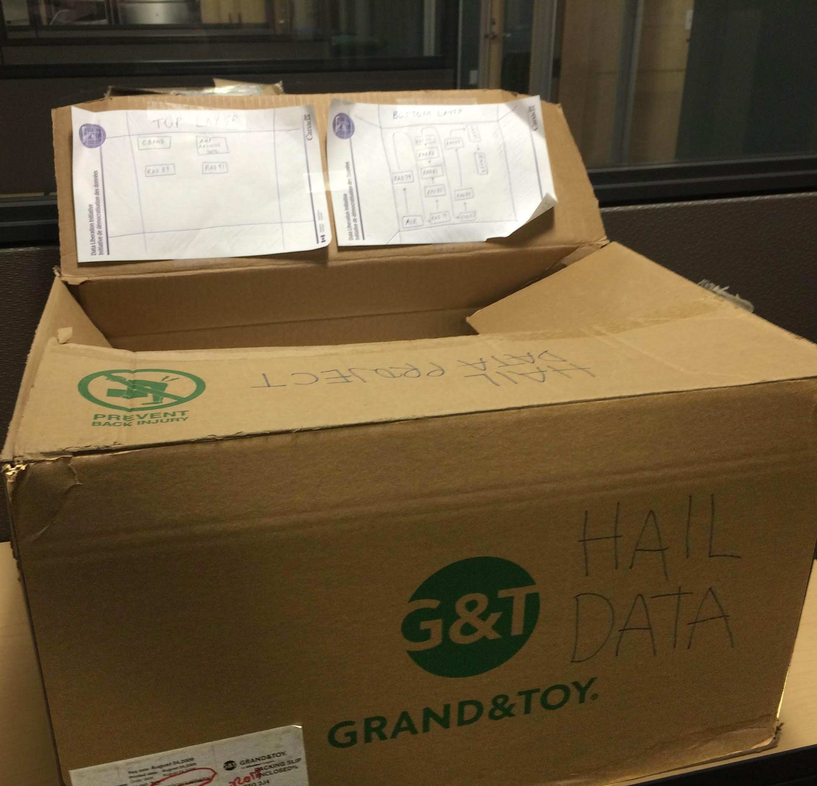
Picture of the box of cds

Slide 8
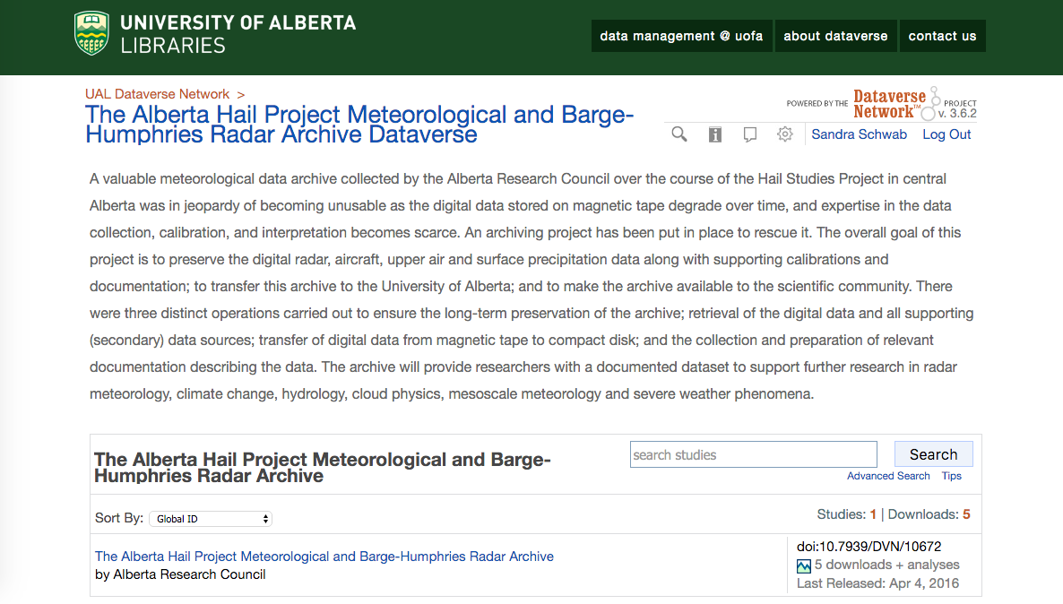

Slide 9
“ARCHIVE YOUR DATA OR THEY DIE WITH YOU”
Thomas Leeper http://bit.ly/1sZvmCD

Slide 10
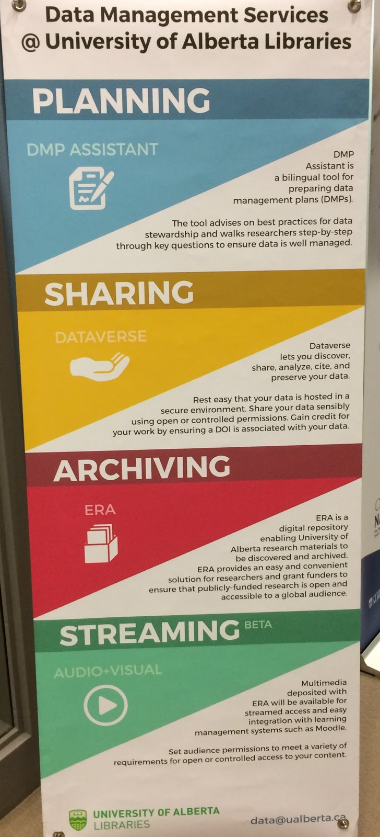

Slide 11
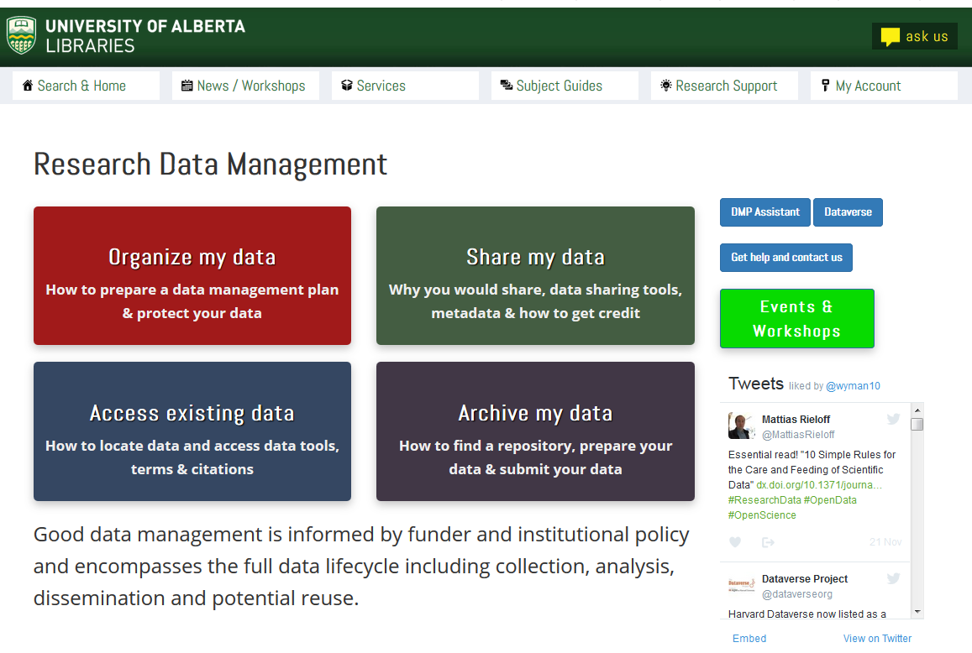

Slide 12
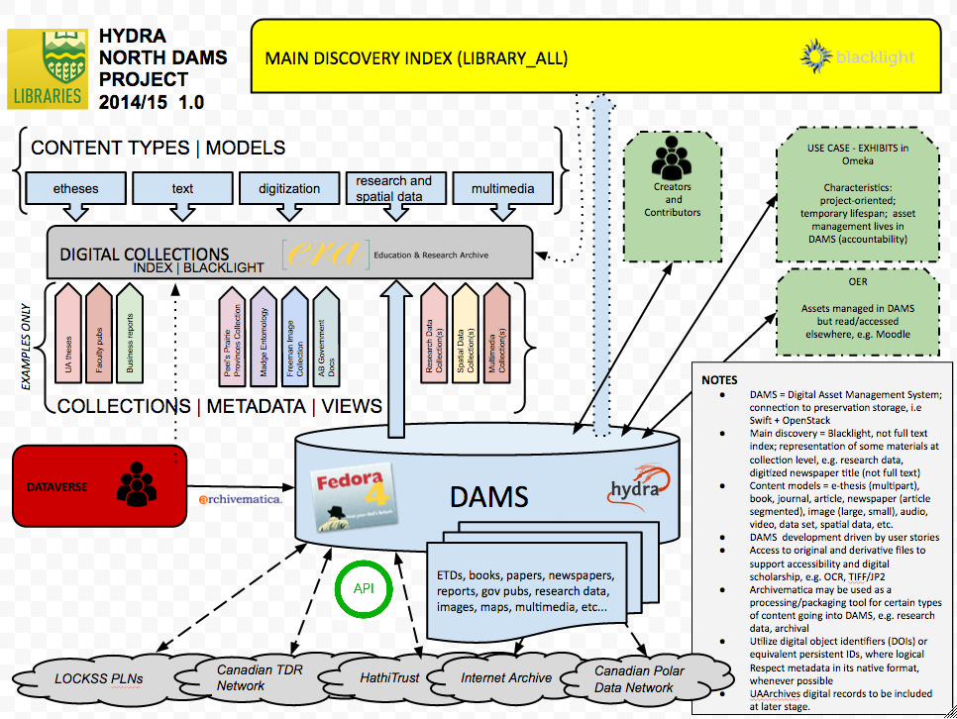

Slide 13
An easy way to share data with one, a few, or many other researchers that does not involve the use of email or Dropbox
An easy way to enter project-level metadata that can be used repeatedly with other applications
An easy way to mint DOIs for data files that can be used in publications
A way to manage multiple versions of data files, including keeping track of changes made to the data
A service that helps organize data to submit for preservation processing

Slide 14
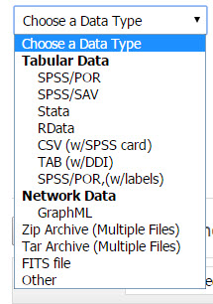
Built for Statistical Data
SPSS
Stata
RData
CSV
TAB
Zip files
Other

Slide 15
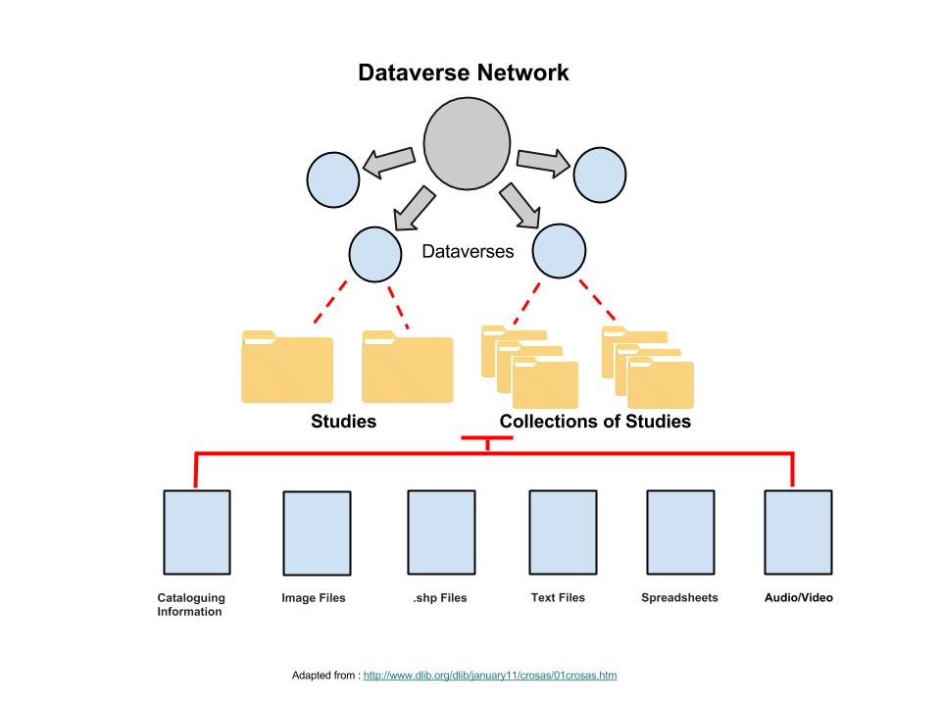
Place to store your data for sharing
A software framework to build data repositories
The data are organized in studies, which contain metadata, data files and complementary files. The studies can in turn be grouped into collections.
Researchers can share, keep control of and get recognition for their data through an easy to use web interface
Datasets
Datasets

Slide 16
Controlled access to data
Can release data to the world (Open Data)
Can release data to a set of University ID’s
Can release data to a predefined group
Can restrict access to the data
Set up a guest book

Slide 17
Metadata
Dataverse allows researchers to describe their studies using an international metadata standard.
Dataverse Compliant with the DDI standard http://www.ddialliance.org/

Slide 18
A valuable meteorological data archive collected by the Alberta Research Council over the course of the Hail Studies Project in central Alberta was in jeopardy of becoming unusable as the digital data stored on magnetic tape degrade over time, and expertise in the data collection, calibration, and interpretation becomes scarce. An archiving project has been put in place to rescue it. The overall goal of this project is to preserve the digital radar, aircraft, upper air and surface precipitation data along with supporting calibrations and documentation; to transfer this archive to the University of Alberta; and to make the archive available to the scientific community. There were three distinct operations carried out to ensure the long-term preservation of the archive; retrieval of the digital data and all supporting (secondary) data sources; transfer of digital data from magnetic tape to compact disk; and the collection and preparation of relevant documentation describing the data. The archive will provide researchers with a documented dataset to support further research in radar meteorology, climate change, hydrology, cloud physics, mesoscale meteorology and severe weather phenomena.
http://dx.doi.org/10.7939/DVN/10672

Slide 19
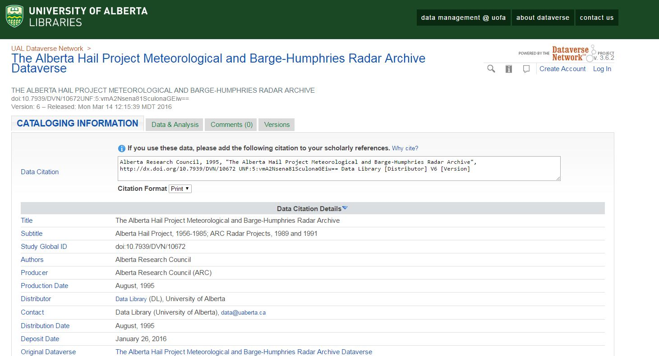

Slide 20
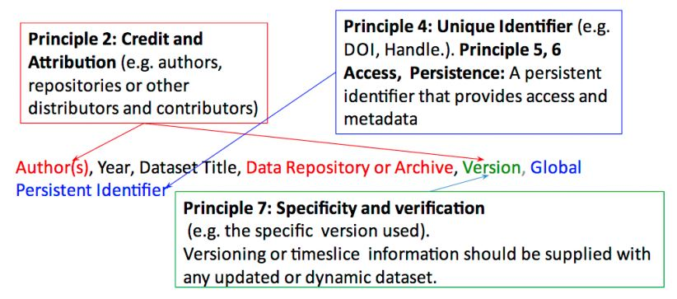
JOINT DECLARATION OF DATA CITATION PRINCIPLES
Importance
Credit and Attribution
Unique Identification
Access
Persistence
Specificity and Verifiability
Interoperability and Flexibility
https://www.force11.org/group/joint-declaration-data-citation-principles-final

Slide 21
DOI Generation in Dataverse
Assigned when upload data not registered until the data are released
Automatically registered with DataCite
https://www.datacite.org/
DOI example: 10.7939/DVN/10242
Digital Object Identifier - "coin of the realm" when it comes to scholarly communication

Slide 22
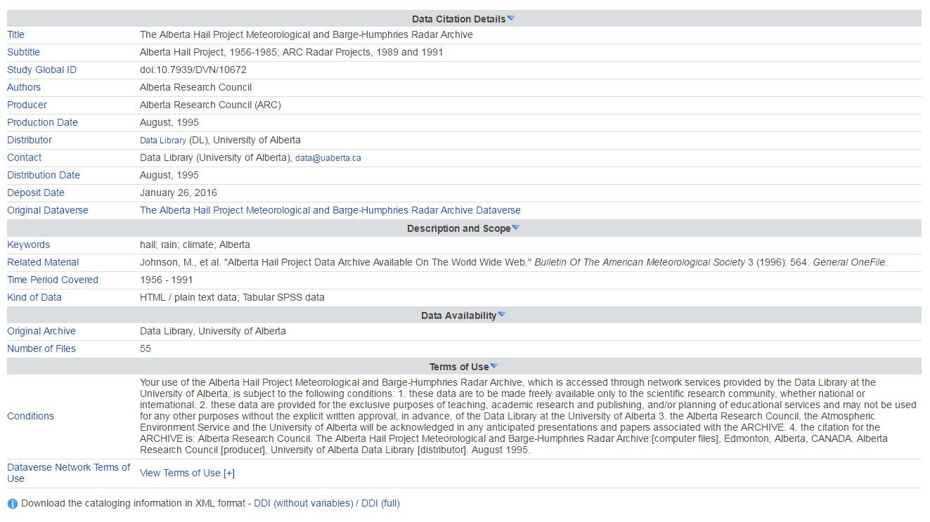
metadata can be harvested by other repositories
ERA
<odesi>
other dataverses

Slide 23
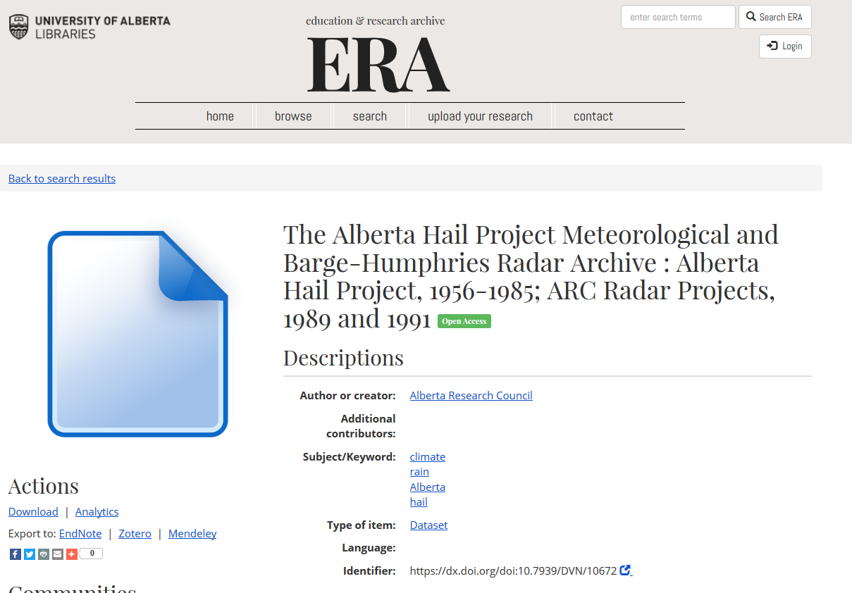

Slide 24
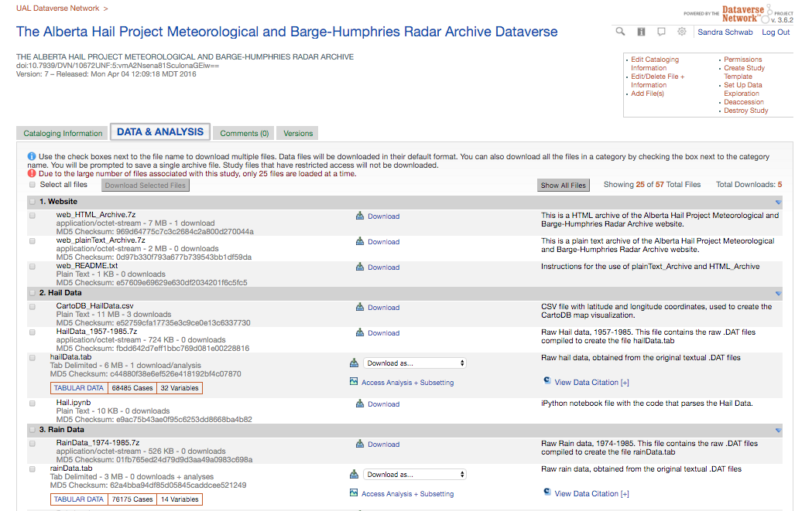

Slide 25
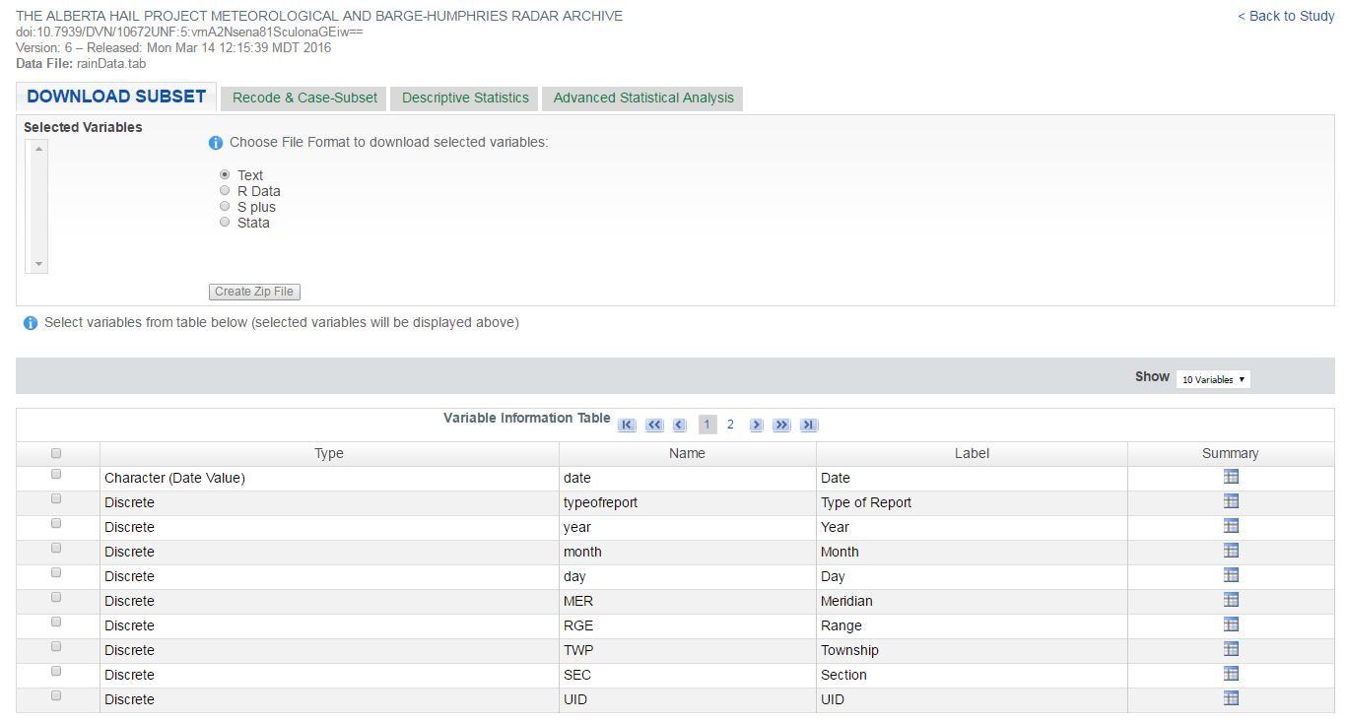

Slide 26
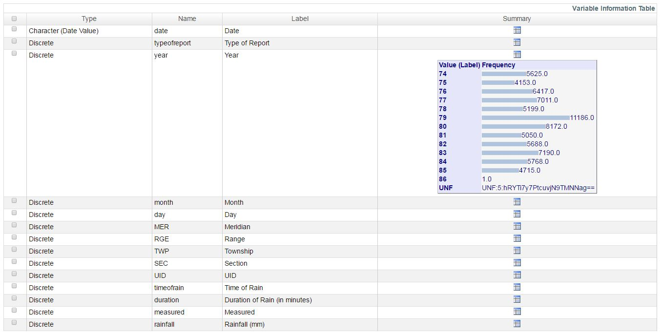
Rain

Slide 27
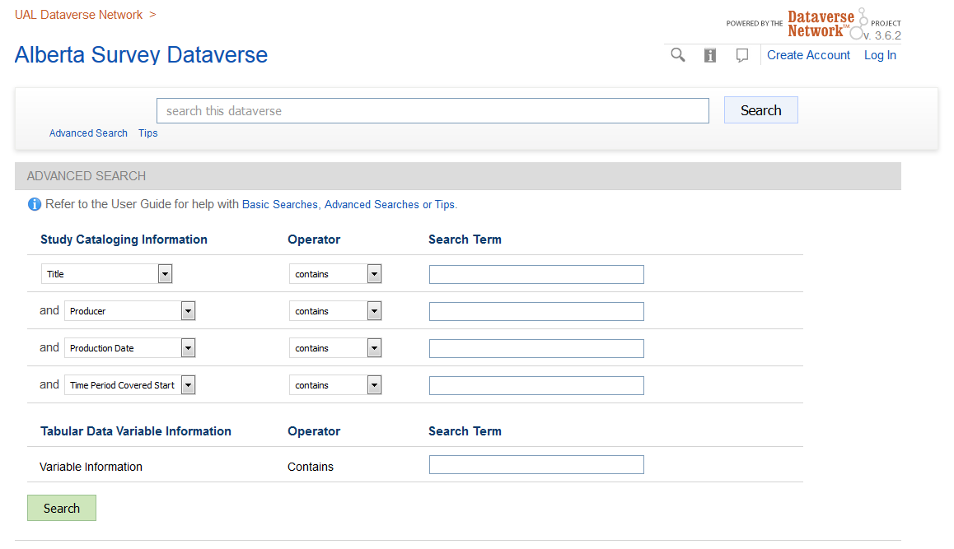
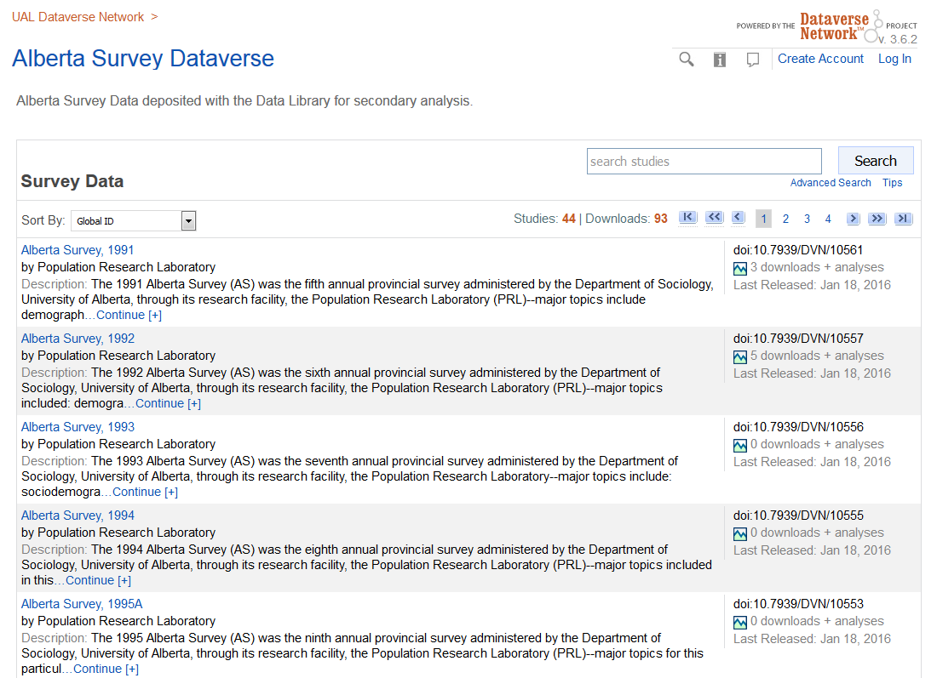
tobacco

Slide 28
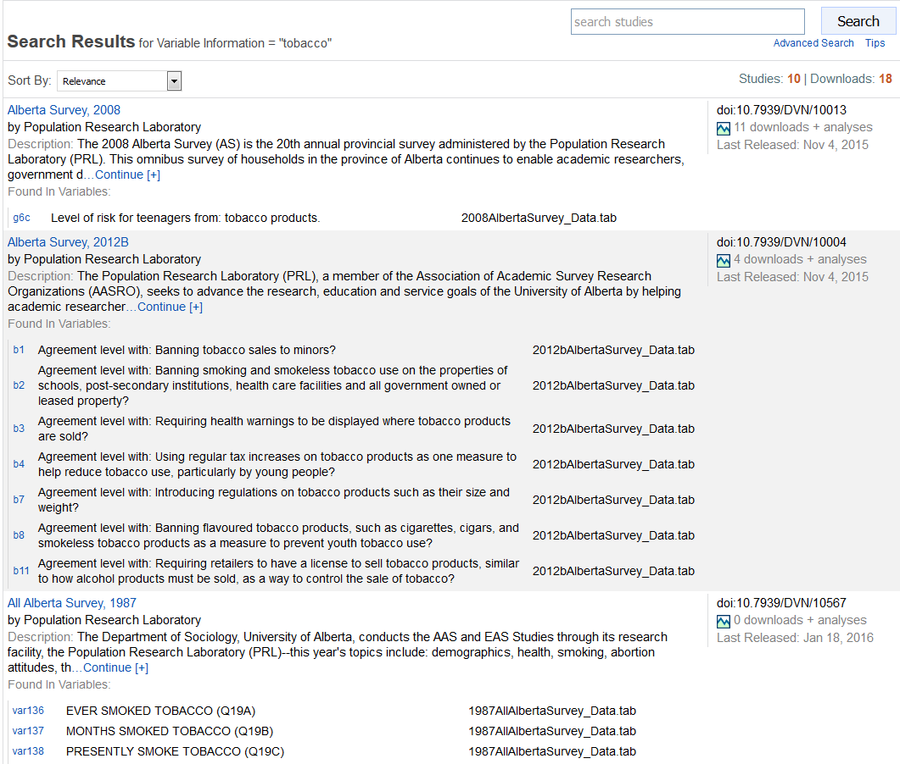

Slide 29
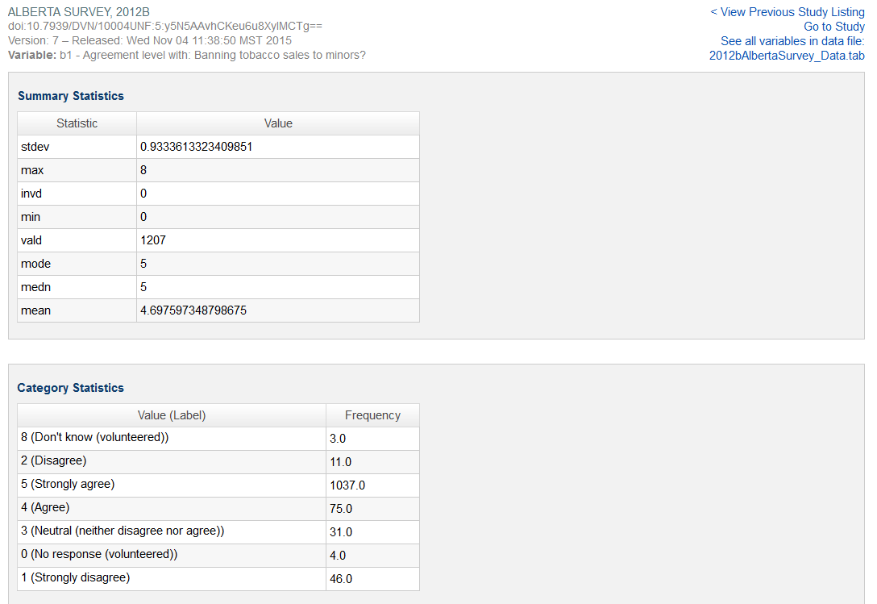

Slide 30
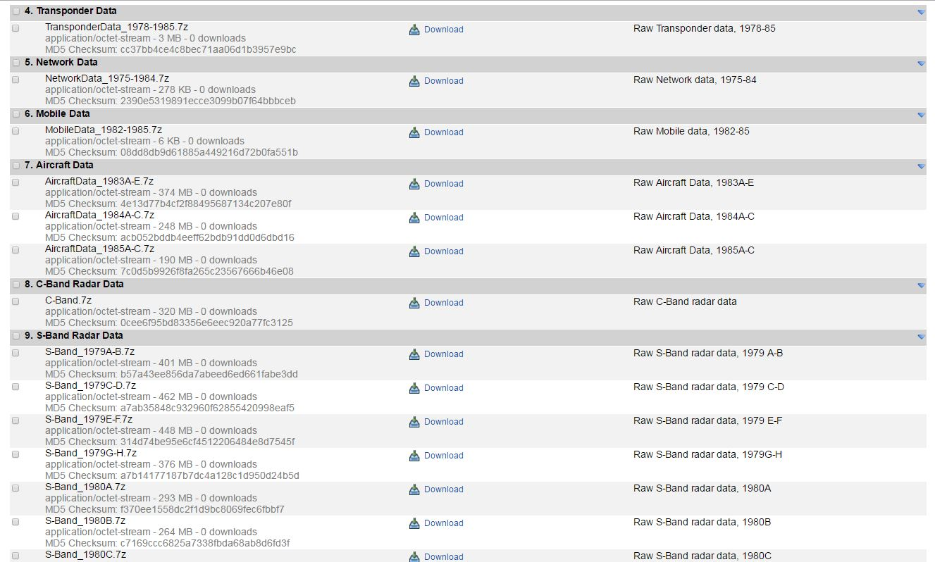

Slide 31
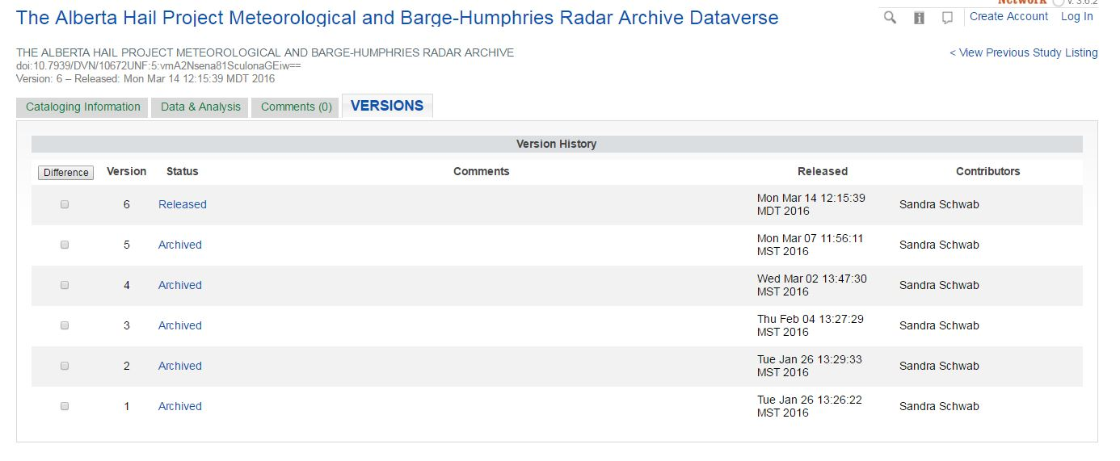
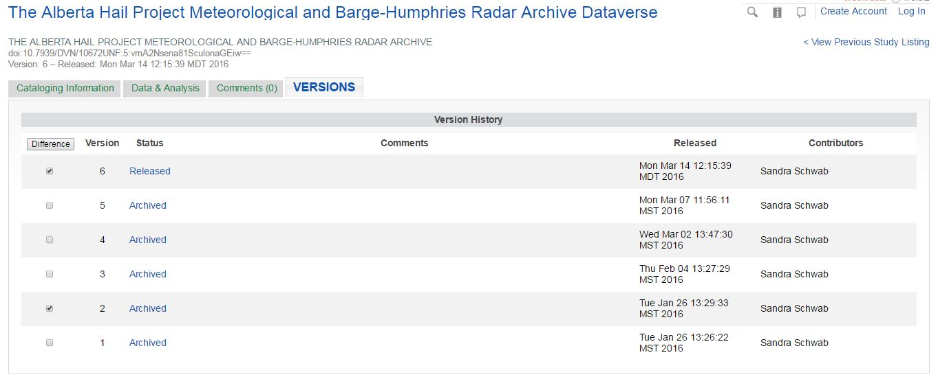
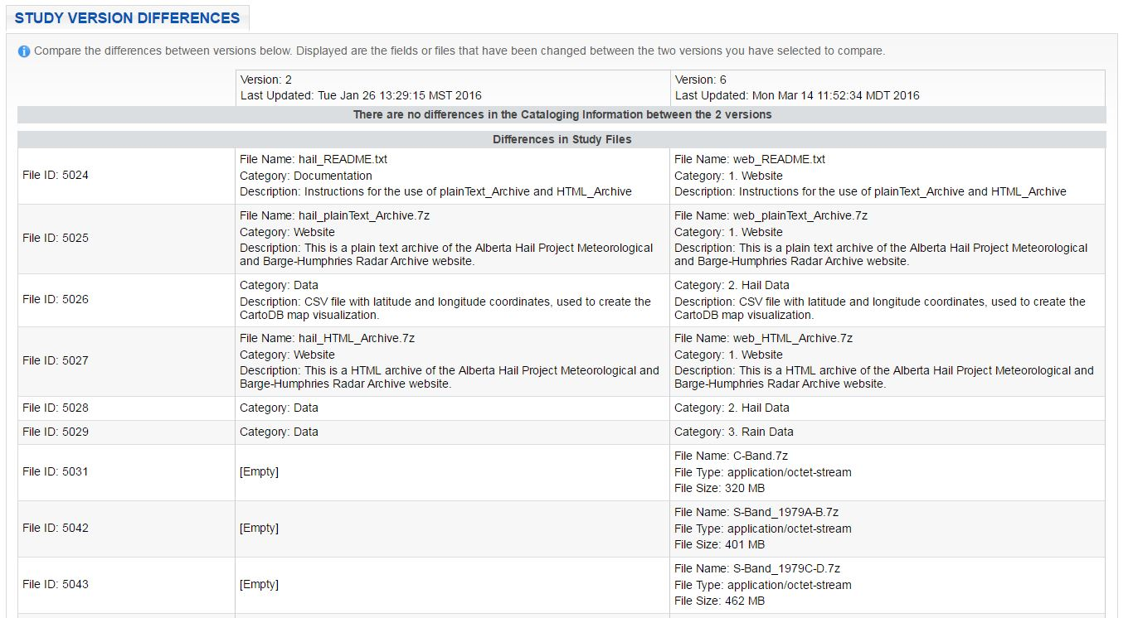

Slide 32
Preservation
Scholars Portal of the Ontario Council of University Libraries is working with IQSS and Artefactual to move studies from Dataverse to Archivematica for the production of Archival Information Packages (AIPs)
Most open data projects are effectively data dumps, without even a basic archival infrastructure.
https://placesjournal.org/article/public-information/

Slide 33
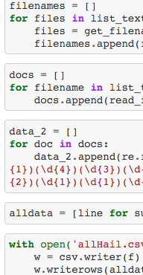
Notes:
SANDRA
Uploaded all of the data to dataverse, and transferred the webpage from a defunct server to google sites.
As I was transferring the data I realized that some of it could be parsed

Slide 34
Parsing the Data
Hail/76HAIL.txt
17652510002938244101001510001800254229999920000133990999219
17652500013532055111001511140111127299999920000199410900419
17652700100345234999901099991200076229999910025099412900999
17652910002049064164501216570109999229999920000099411900919
17652900101038154120000511550259999329999920000125411900999
17653101002046045163700916250559999299999910152099410900019
17653100013237075172003017100459999329999930020140431999399
File format changed from .DAT to .TXT
using Automator for Mac
Regular expression in Python parses each line of text...
r'^(\s)(\d{1})(\d{2})(\d{1})(\d{2})(\d{4})(\d{2})(\d{2})(\d{2})(\d{1})(\d{4})(\d{3})(\d{4})(\d{3})(\d{1})(\d{3})(\d{1})(\d{1})(\d{1})(\d{4})(\d{1})(\d{4})(\d{1})(\d{2})(\d{1})(\d{1})(\d{1})(\d{1})(\d{2})(\d{1})(\d{1})(\d{1})
[(' ', '1', '76', '5', '25', '1000', '29', '38', '24', '4', '1010', '015', '1000', '180', '0', '254', '2', '2', '9', '9999', '2', '0000', '1', '33', '9', '9', '0', '9', '99', '2', '1', '9')]
...storing the numbers as a comma separated list
https://github.com/mediagestalt/Hail

Slide 35
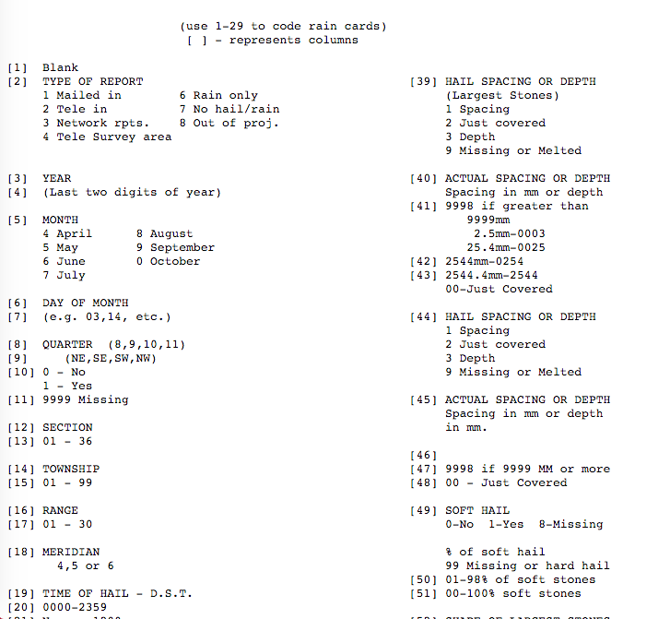
[
Time & Date
{
Geographical
Data

Slide 36
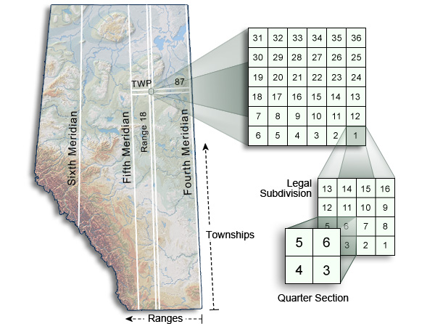
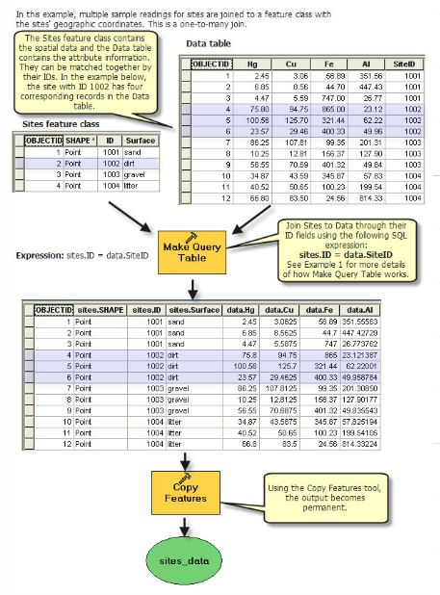
GIS Ready
Geocode
Make Query Table

Slide 37
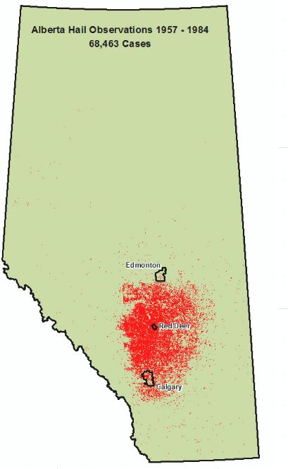
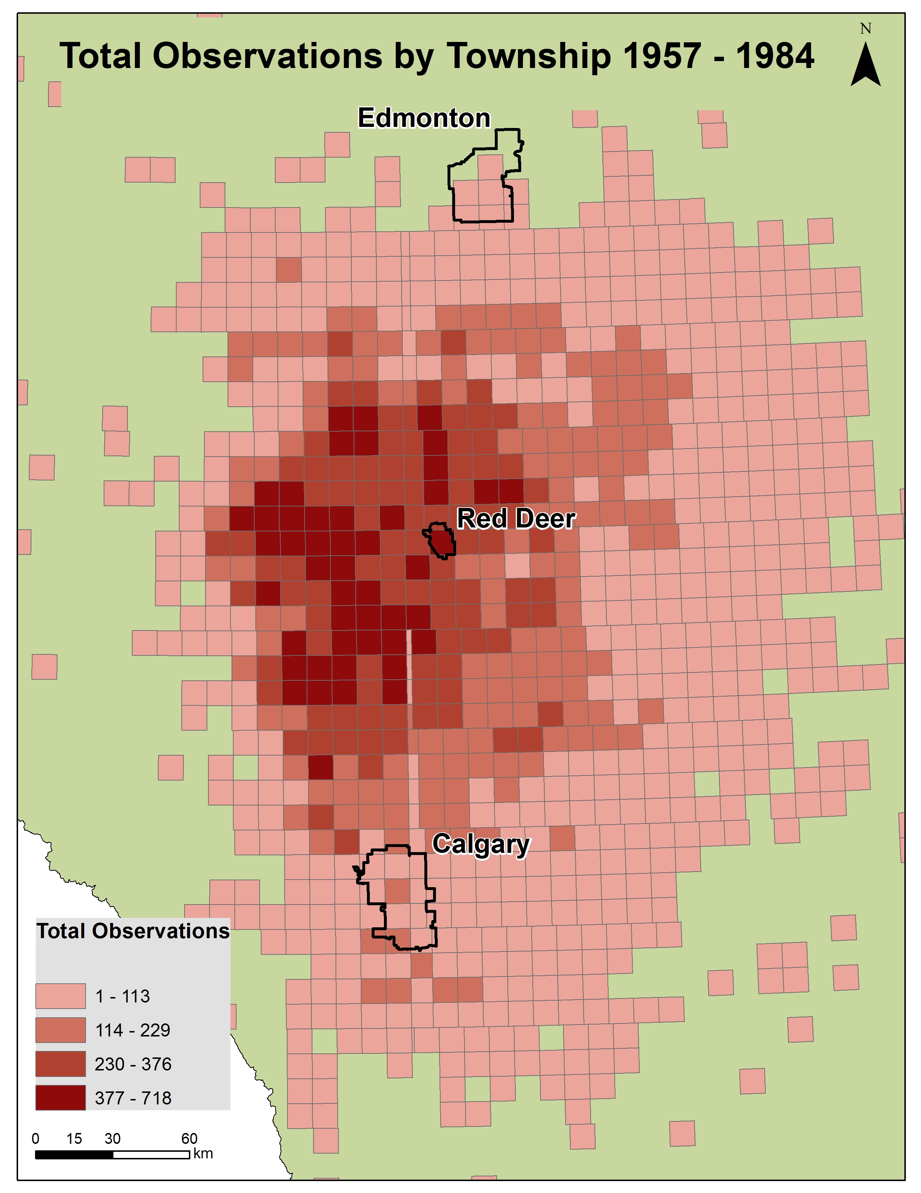
Intersect
Dissolve
sum
Joins Relates

Slide 38
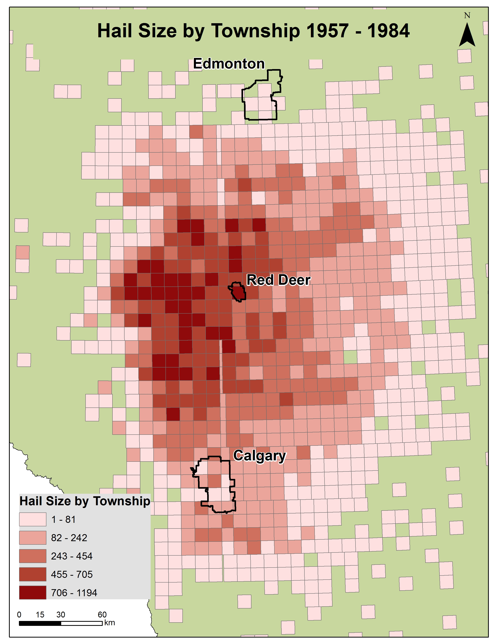
colonial stamp chaining the land 66 feet at a time

Slide 39
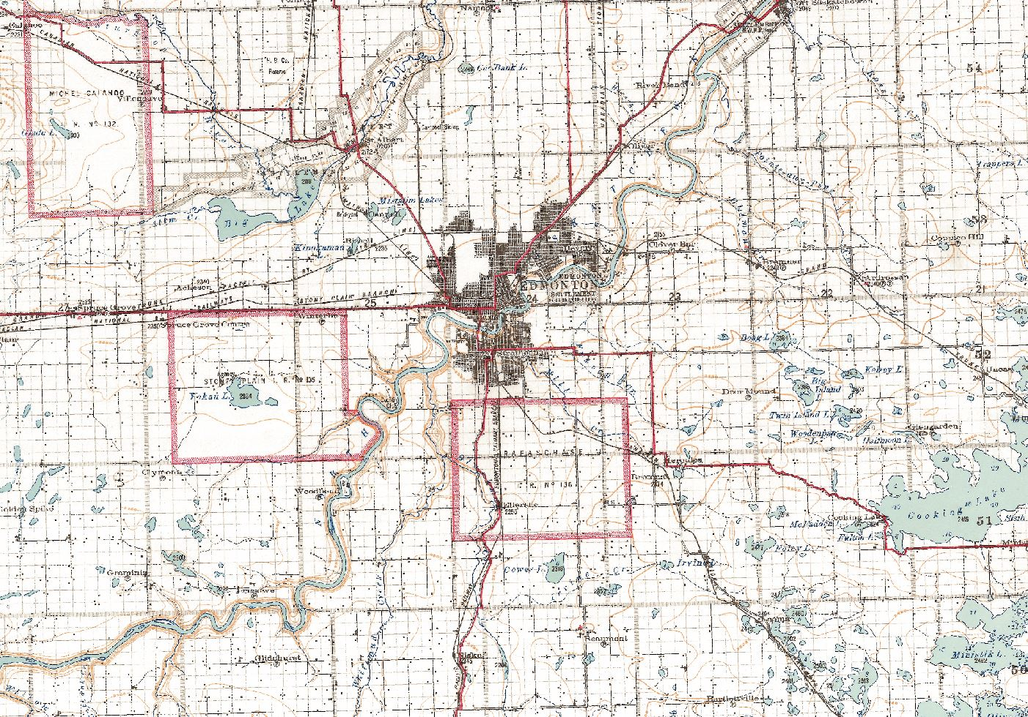
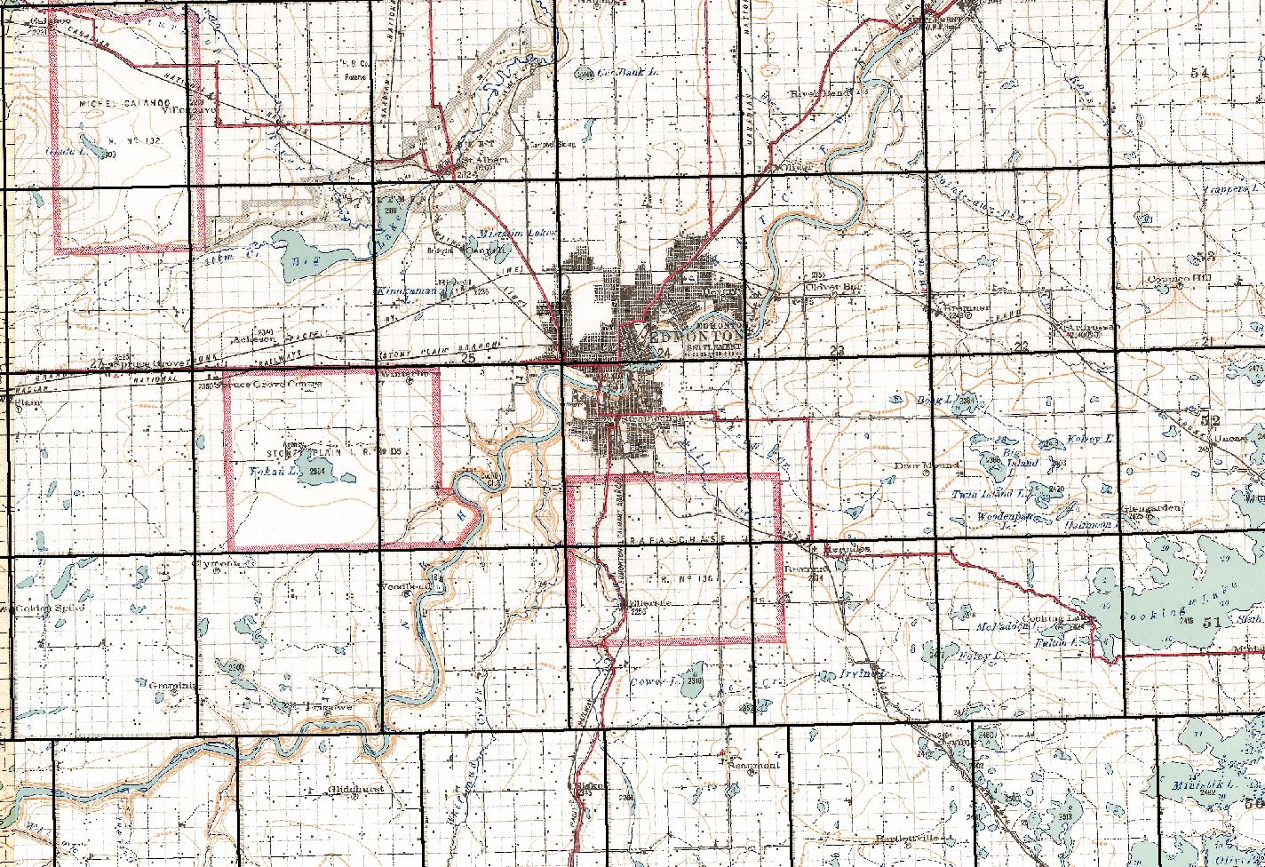
THE THREE MILES TO ONE INCH SECTIONAL MAPS OF WESTERN CANADA

Slide 40
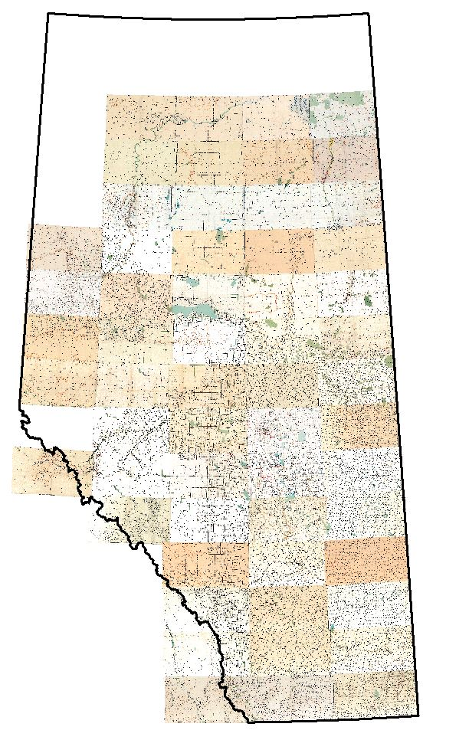
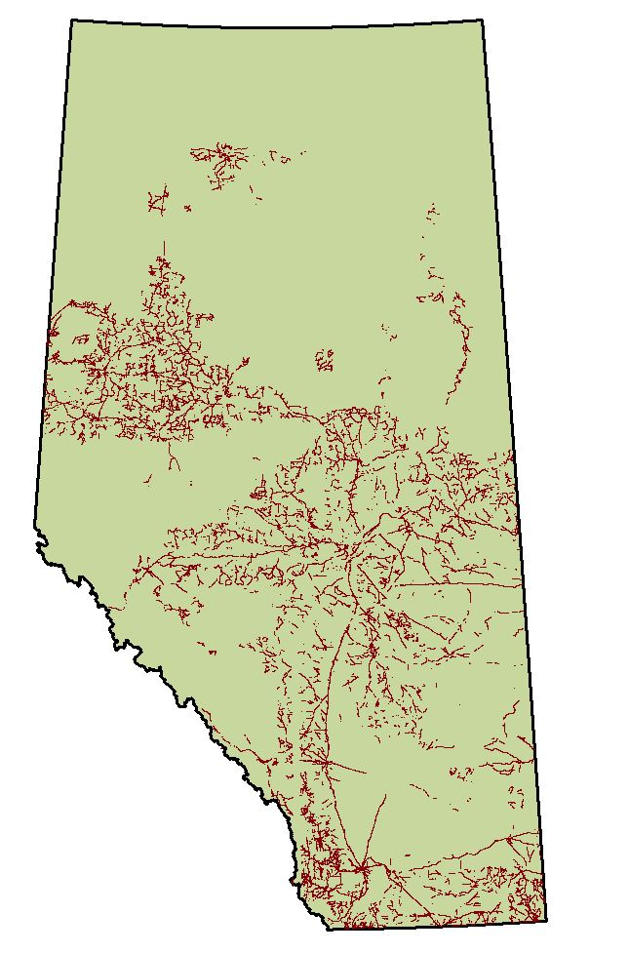
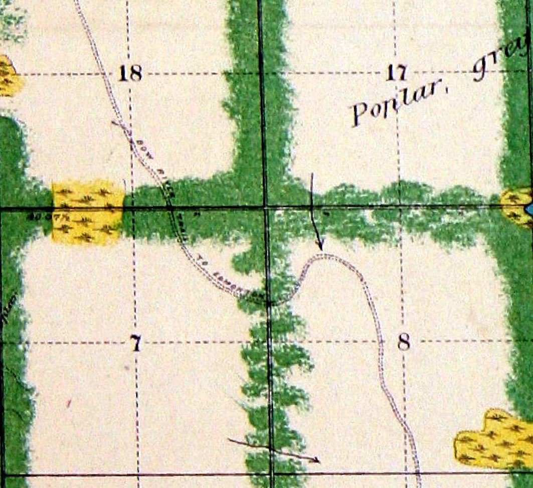
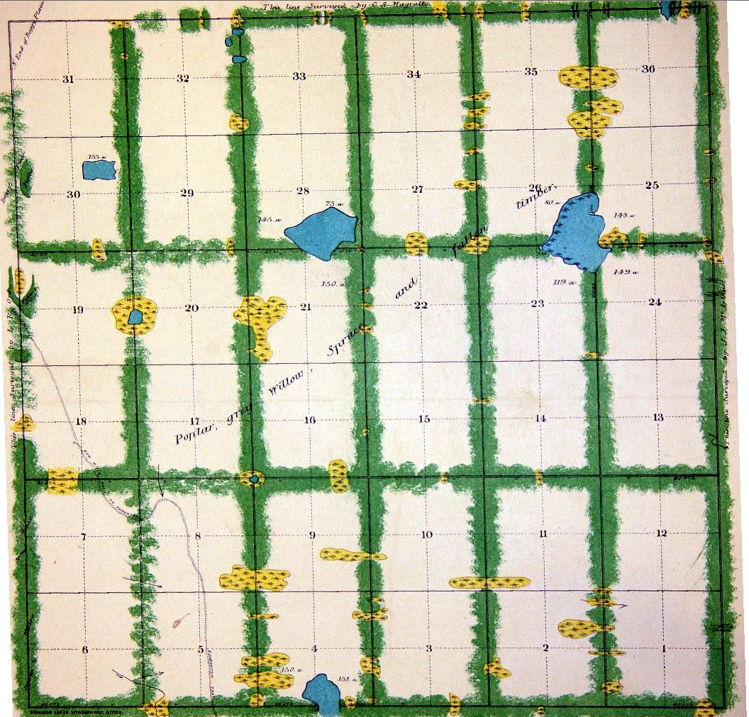

Slide 41
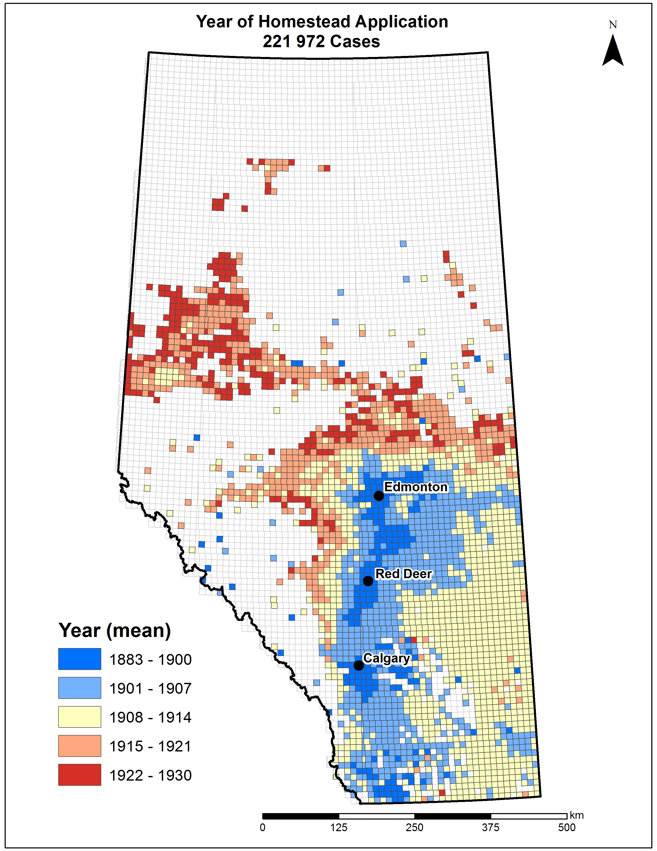
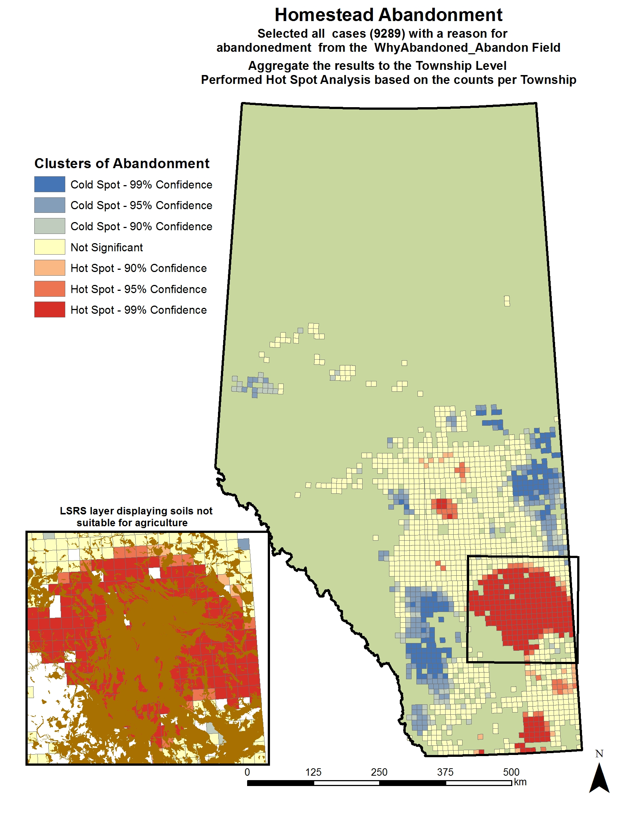
Last Best West: The Alberta Land Settlement Infrastructure Project (ALSIP)

Slide 42
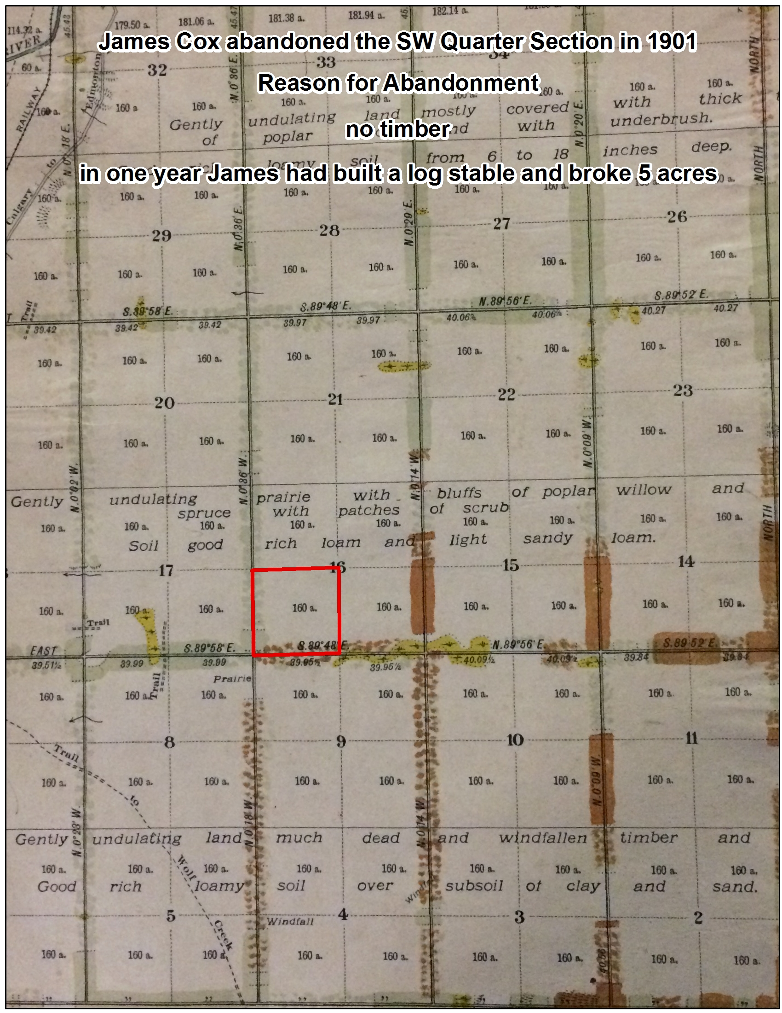
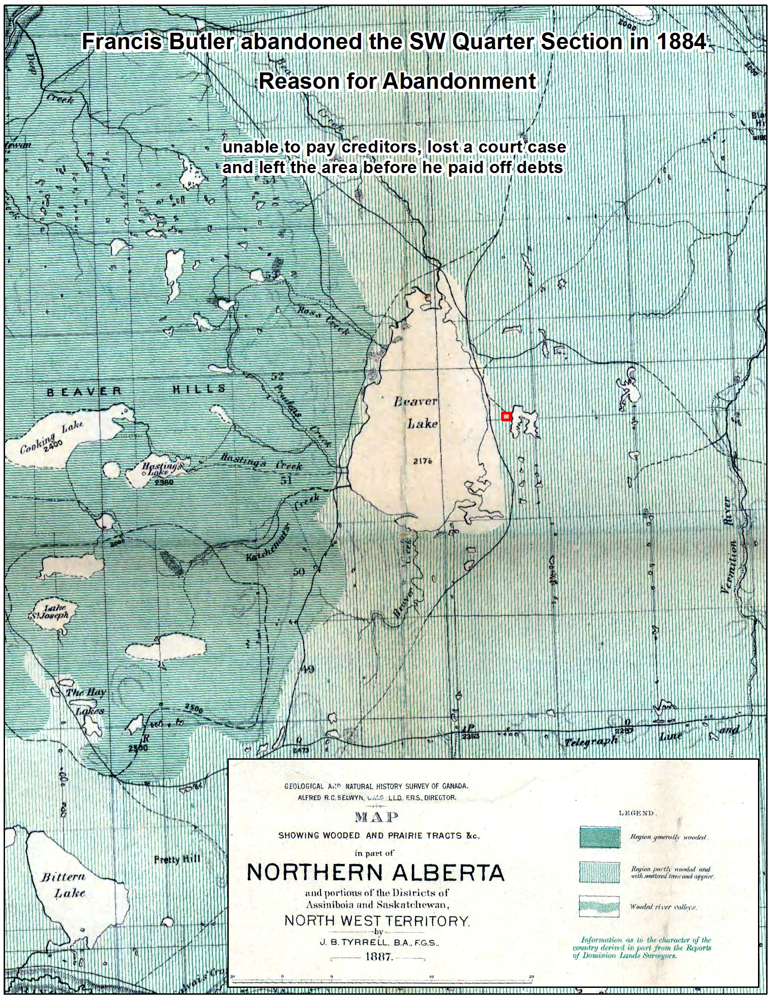



Slide 43

)
(
Crop Type & Damage
Hail Size
Citizen Science

Slide 44

Diachronic Visualization of Hail Stone Size in Central Alberta: a Map-Making Tutorial Using CartoDB
http://mediagestalt.com/maps/hail.html

Slide 46


